Slide 1
URL Shortening Web Service
Chengzhang Ma
Wanxin Yuan

Slide 2


Outlines
Introduction
Use Cases
System Diagram
Front-end Design
Back-end Design
Challenges and Highlights
Improvements
Demo

Slide 3




Introduction
Long URL
Short URL
http://ihprd.siss.duke.edu/psp/IHPRD01/EMPLOYEE/SA/c/DU_WORKCENTER.DU_WORKCENTER_09.GBL
http://shortenedURL/abcdef

Slide 4

Use Cases
Enters a long URL for shortening.
Customizes user’s own shortened URL.
Redirects the shortened URL to original long URL.
Keeps track of click data of a shortened URL.

Slide 5
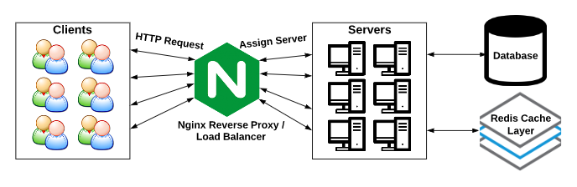
System Diagram

Slide 6

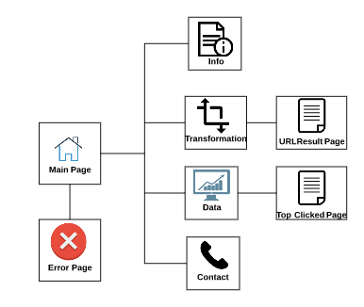


Front-End Design

Slide 7
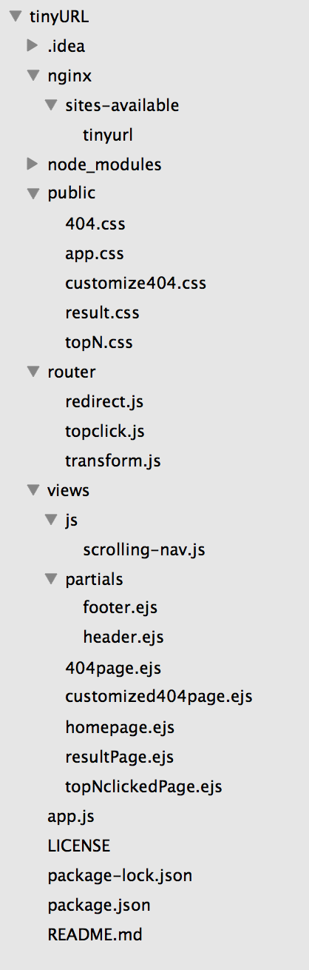




Back-End Design

Slide 8
Challenges and Highlights
Post/Redirect/Get
Asynchronous Function
Click Data
Transformation Algorithm

Slide 9

Improvements
Top N Clicked URL
More Click Data
Apache Cassandra
Better Schedule

Slide 10
Demo
URL Shortening Web Service vcm-3215.vm.duke.edu:80

Slide 11
Thank you!

